Slide 1

Compositional Reasoning of P programs
P Language
Ankush Desai
University Of California, Berkeley

Slide 2
Recap
P program is a collection of state machines.
P provides primitives for modeling non-determinism and performing “unit” testing.
P compiler generates both code for systematic testing and C/C++ code for execution.
P systematic testing engine is able to reproduce hard to find heisenbugs in asynchronous message passing programs.

Slide 3
Building Distributed Systems is Challenging
Multiple components (protocols) interacting.
Nondetermism: Failures, Asynchrony ..
State space explosion !
Traditional exhaustive or random search techniques do not scale.
Inadequate test coverage.
In practice, bugs are generally found in production or after deployment !

Slide 4
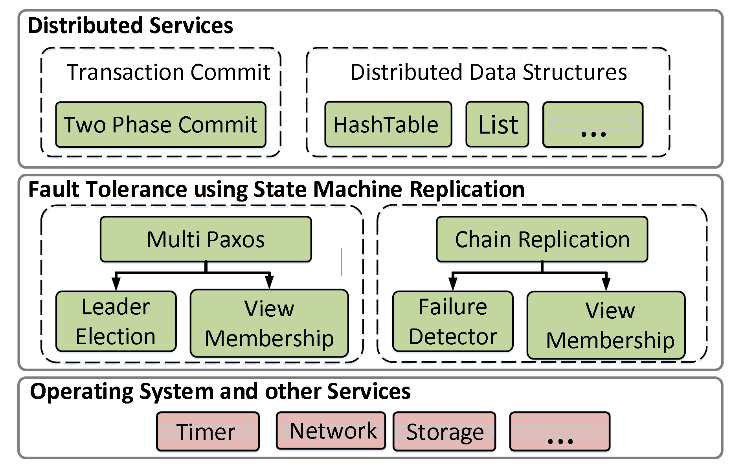
Fault Tolerant Distributed System
Software stack of a fault-tolerant distributed application
state machine replication is a general method for implementing a fault-tolerant service by replicating logs.

Slide 5
Fault Tolerant Distributed System
Observations:
Monolithic testing does not scale.
No component substitution and hence, no re-use of the systematic testing effort.
Solution:
Test-amplification via abstractions: Test each component in Isolation.

Slide 6
Fault Tolerant Distributed System
Solution:
Test-amplification via abstractions: Test each component in isolation.
Theory of Compositional Refinement:

Slide 7
Compositional Reasoning

Slide 8
Assume Guarantee Reasoning

Slide 9
Compositional Reasoning of Distributed Systems

Slide 10
Test-Coverage Amplification

Slide 11
Test-Coverage Amplification

Slide 12
Compositional vs Monolithic

Slide 13
Module

Slide 14
Module Contructors

Slide 15
Union

Slide 16
Compose

Slide 17
Substitution

Slide 18
Substitution

Slide 19
Example
Revisit PingPong

Slide 20
Example
Compositional Reasoning and Refinement Checking

Slide 21
Hiera

Slide 22
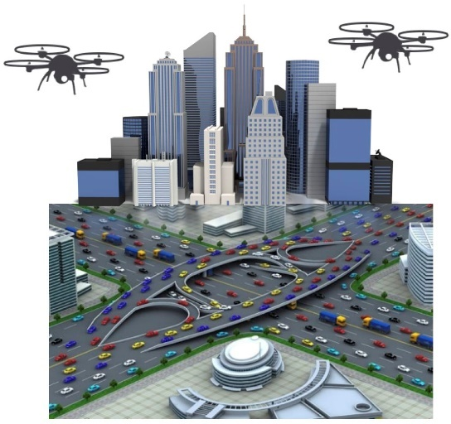
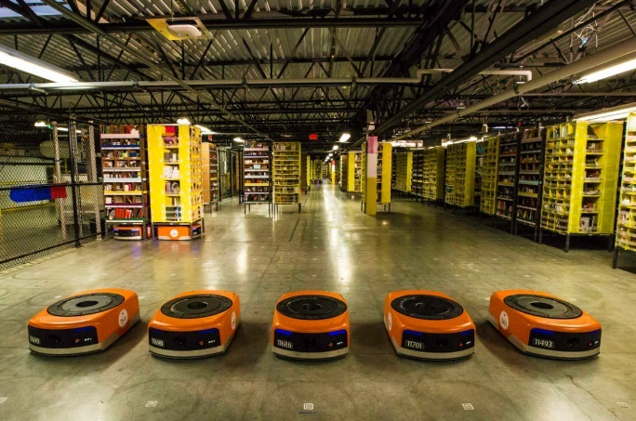
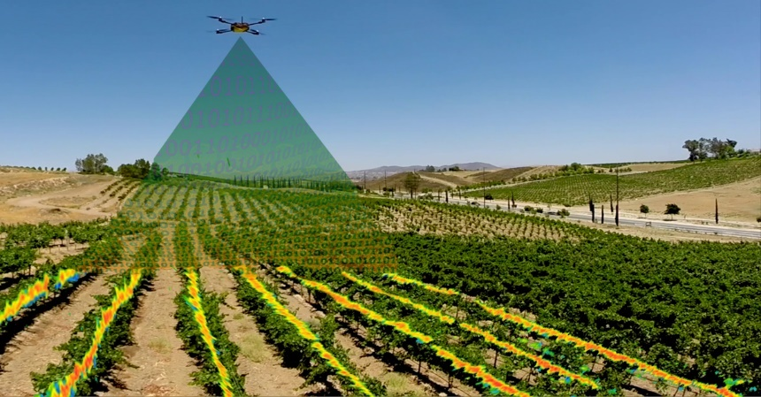
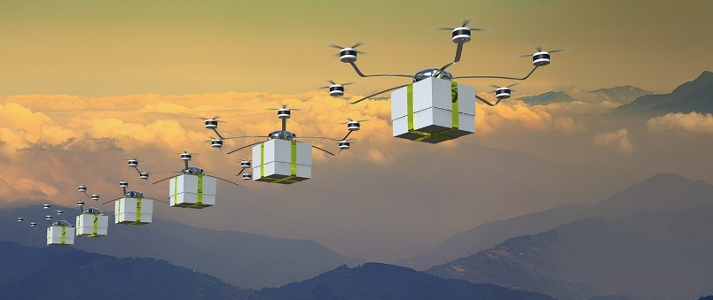
Autonomous Mobile Robotics
Warehouse
A major challenge in autonomous mobile robotics is programming robots with formal guarantees and high assurance of correct operation.
Surveillance
Delivery Systems
Agriculture
Notes:
Recent advances in autonomous robots collaborating to accomplish complex missions have been brought back exciting times for robotics research.
They have been applied to build real world systems and found applications in areas like

Slide 23
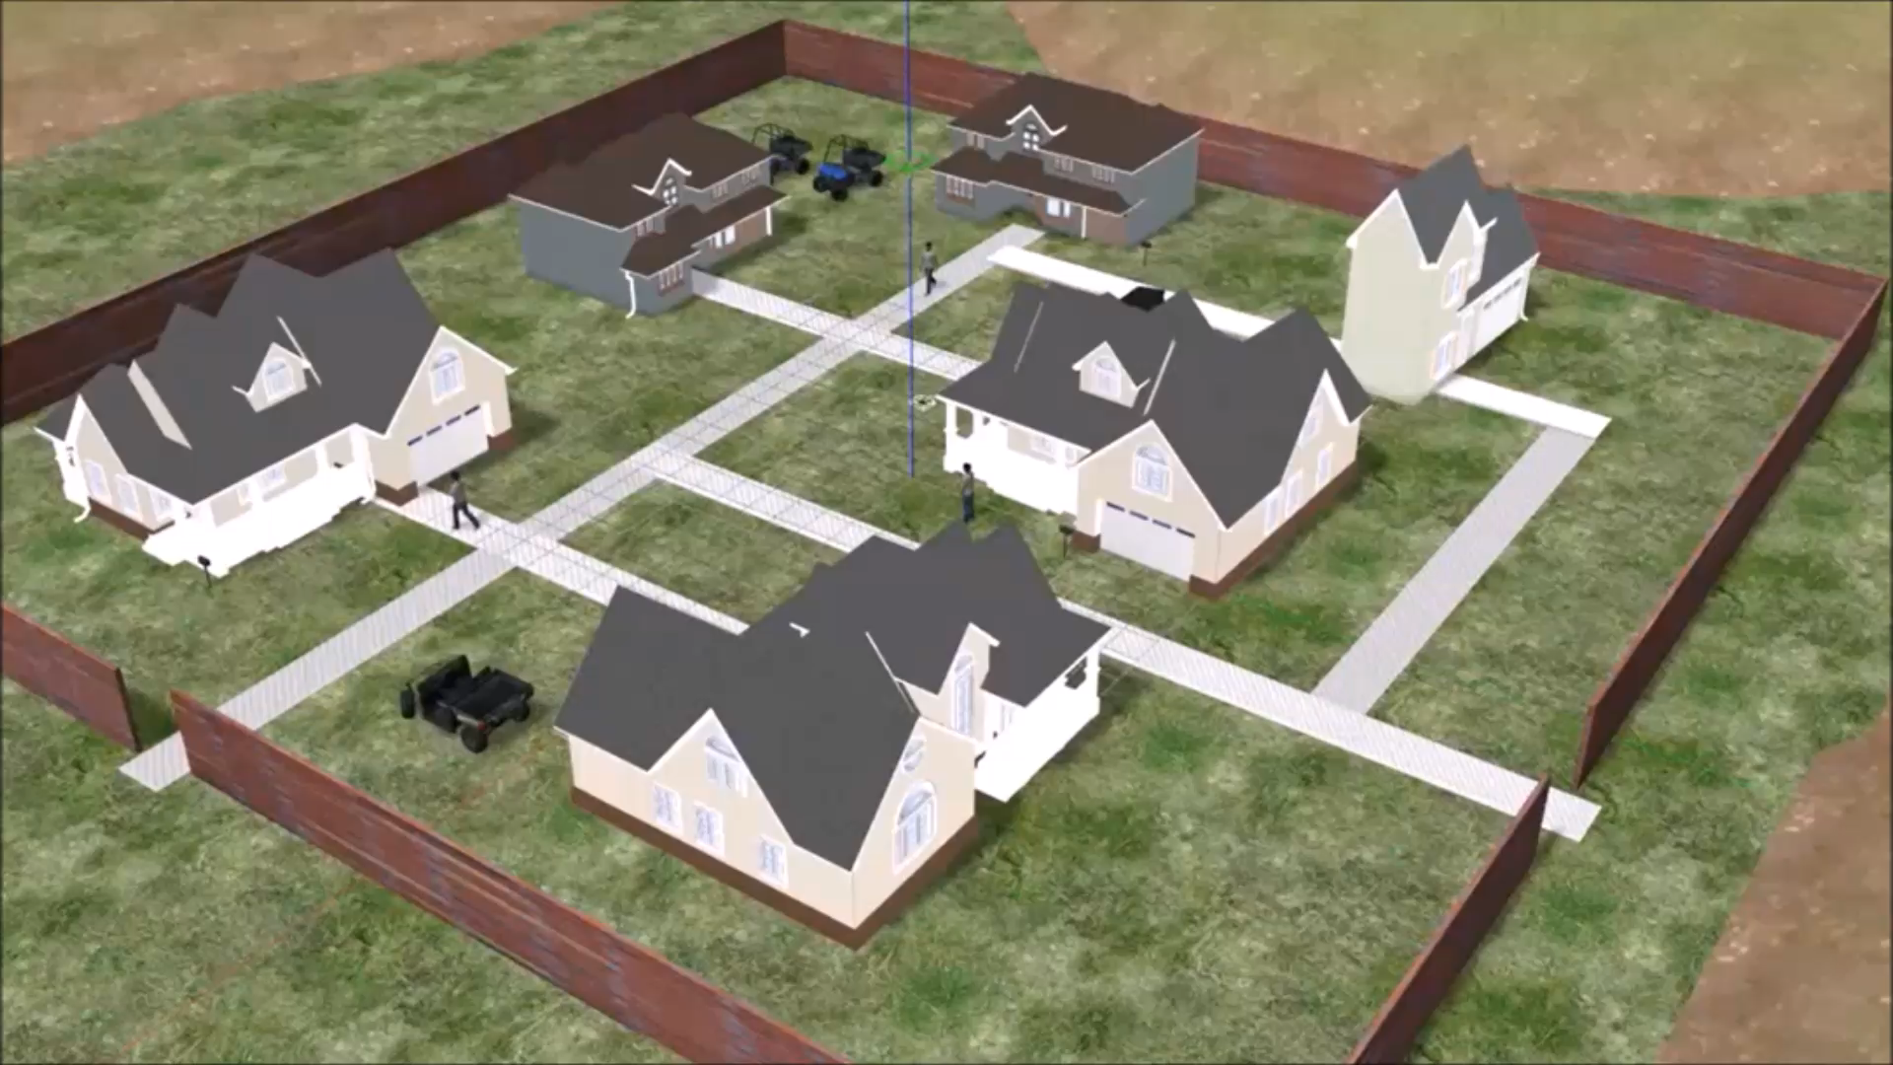
Demo Video

Slide 24
Thank You
DRONA is available on GitHub.
http://drona-org.github.io/Drona/

